Slide 1
R. Moshe Tendler z’tl and the Halachic Definition of Death
Noam Stadlan, MD MS(bioethics)

Slide 2
Disclosure
Member of the Board of Directors of the Halachic Organ Donation Society for many years
I have declared patients dead based on cessation of respiratory/brain function and they have gone on to donate organs, including hearts

Slide 3
Brief Biography
Born August 7, 1926
BA from NYU in 1947
Semicha from REITS 1949
Masters in 1950
PhD in microbiology from Columbia 1957
Rav of the Community Synagogue of Monsey
Taught at YU/REITS for many years
President of the Association of Orthodox Jewish Scientists 1971-2
Posek for the AOJS and the associated Rephael Society(medical related professionals)

Slide 4
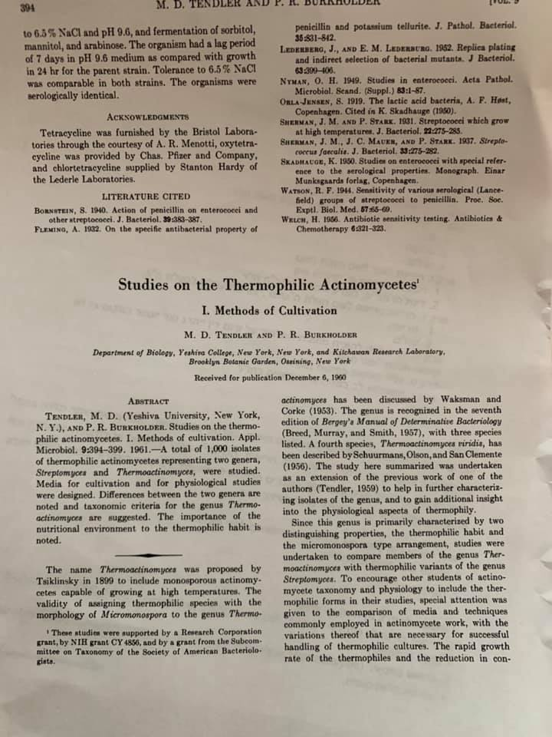

Slide 5
Context
Societal
Specific cultural/philosophical/scientific understandings and assumptions
Identifying and understanding underlying assumptions is crucial for coming to coherent conclusions

Slide 6
“The reliance of traditional Torah law on the laws of science to make its rulings is the result of the Jewish definition of monotheism that declares total identity between the God that gave us the laws of nature and the God that gave us His ethical principles on Mount Sinai.”
Regrettably, too many have become spokesmen for the Orthodox Jewish position despite their unfamiliarity with God’s natural laws, or His rules for human conduct or both.

Slide 7
Anatomy
The heart has its own pacemaker and will beat as long as it receives oxygenated blood(which it supplies to itself)
The brain makes the diaphragm move and breathing stops when the brain stops
Without oxygenated blood, the organs of the body fail at different rates and permanent damage sets in at different rates

Slide 8
What is the source discussing?
Concept- what is the essence of life?
Criteria- what tests and what results reveal life present or not?

Slide 9
assumptions
Cessation of function of one crucial organ implies cessation of all organ function
Artificial respiration
Artificial circulation
Myth of body unity
Once the myth of body unity is discarded, it is necessary to identify what part of the body is crucial to human life.
Those who mention circulation without specifying where the circulation has to go and what function the circulation has to support are operating under the myth of body unity.
What anatomy and/or function define a human body?

Slide 10
Early Modern context- theoretical versus practical
Fred Rosner “Definition of Death in Jewish Law. Tradition Fall 1969 10:4
“Most Talmudic and post Talmudic Sages agree that the absence of spontaneous respiration is the only sign needed to ascertain death.”
R. Weiss, R Waldenberg and others addressing Heart Transplantation- require the cessation of heart and respiratory function

Slide 11
Harvard Criteria
A definition of irreversible coma. Report of the Ad Hoc Committee of the Harvard Medical School to examine the definition of brain death.[No authors listed]JAMA. 1984 Aug 3;252(5):677-9.
Dependent on current technology
Whole brain concept, tested only the brainstem
Tests available- EEG, angiogram, nuclear medicine tests
No brainstem reflexes
No breathing(apnea)
Assumption- no blood flow- the whole brain rots

Slide 12
Another option- brainstem death
Brain death
a clinical and pathological study
A. Mohandas M.D.¹ and Shelley N. Chou M.D., Ph.D
Journal of Neurosurgery Volume 35: Issue 2 (Aug 1971)
Only cessation of brainstem function necessary to determine death

Slide 13
Conceptual options- Harvard criteria didn’t provide a concept of why cessation of brain function was death
Whole brain death
Brainstem death
Cerebral death(can still have brainstem function)- usually considered permanent loss of consciousness
  Death is considered the loss of ‘personhood’
  Rejected by most

Slide 14
Halachic options
Loss of breathing
Decapitation
Hybrid
  Loss of breathing with cessation of consciousness
  Gittin- someone whose throat is cut can divorce his wife
  Vilna Gaon on Ohalot-

Slide 15
Something to consider
What are the Halachic non-brain based definitions of human life and death?
Perhaps what we are seeking is not THE definition of death, but the BEST definition of death

Slide 16
The First Halachic suggestion for brain death
R. Gedalya Rabinovitch and Dr. Mordechai Koenigsberg
HaDarom 32 Tishrei 1970
Significant opposition from Dr. Yaacov Blidstein and others

Slide 17
R. Tendler
“Brain Death: A Status Report of Medical and Ethical Consideration” JAMA 1977 238:15 pages 1651-1655(part 2 Vol 238 no. 16 pp 1744)

Slide 18
JAMA article
Total destruction of the brain constitutes a determination of death that is not in conflict with…Orthodox Jewish law
Includes the specifics of the Harvard criteria
Complete destruction of the brain…can be considered physiological decapitation and thus a determinant per se of death of the person.
Loss of the ability to breath spontaneously is a crucial criterion for determining whether complete destruction of the brain has occurred.

Slide 19
JAMA article cont
Spontaneous respiration is an indicator of the living state
It cannot be considered its definition, since a respirator patient whose sole defect is paralysis of the motor neurons of respiration… is surely fully alive.
To define death in biblical terms, loss of respiration must be combined with other more obvious evidence of the nonliving state
Such evidence would be provided by the…criteria that allow a physician to determine that complete and irreversible destruction of the brain or physiological decapitation has occurred.

Slide 20
JAMA (one more)
Higher integrative functions..are carried out by parts of the brain other than the brainstem. Irreversible loss of these functions, signifying destruction of corresponding parts of the brain, does not alone constitute a determination of death.
Coincident loss of vegetative functions, represented by loss of spontaneous respiration and indicating the destruction of the brainstem is also a requisite.
Thus destruction of the entire brain or brain death, and only that, is consonant with biblical pronouncements on what constitutes an acceptable definition of death
IE a patient who has all the appearances of lifelessness and who is no longer breathing spontaneously is dead

Slide 21
JAMA (last one?)
Brain death is only professional jargon to describe a patient who exhibits a permanent loss of signs of life, such as spontaneous movement and responsivity, and has permanently lost the ability to breath spontaneously
There is a distinction between cellular death and organismal death
Once death of the person has occurred and can be determined, there is no biblical obligation to maintain treatment or artificial support of the corpse. Thus, according to R. M. Feinstein, there is no religious imperative to continue to use a respirator to inflate and deflate the lungs and thus maintain the cellular viability of other organs in an otherwise dead patient(written communication May 5 1976)

Slide 23
Halacha Bulletin(renamed Practical Medical Halacha)
Originally a monthly formal responsum to a halachic question of interest to the members edited and circulated by Dr. Fred Rosner and R./Dr. Moshe Tendler
Compiled for publications
From the introduction 1980
“…[the] calls for assistance in dealing with ethical and moral issues are met in a clear, definitive fashion with halachic responsa that are intended to be helpful in a direct, practical way….the terminology…identify them as intended solely for a professional readership. They are not intended for the general layman interested in halacha whose medical background is not adequate to prevent misinterpretations and misunderstanding. They were issued as ‘first-aid’ measures…on critical halachic issues.”

Slide 24
The role of R. Moshe Feinstein
“because of the far-reaching significance of many of these halachic decisions, they were submitted to Hagaon Moshe Feinstein for review. The language and analyses, however, are those of the authors, who bear sole responsibility for the accuracy of the contents.” - R Moshe Tendler, PhD
“A recent responsum on the definition of death and on human experimentation by R. Moshe Feinstein has also been included.”- R. Tendler 1978

Slide 25
Definition of Death(separate from the R. Moshe teshuva)
The absence of spontaneous respiration and absence of palpable pulse are the cardinal signs for ascertaining death
Cerebral death(flat EEG) is not an acceptable criterion of death in Jewish Law
Total cessation of all brain function as determined by the “Harvard criteria” and radio-isotope confirmation that the brainstem is not being perfused is absolute evidence that death has occurred

Slide 26
Practical Medial Halacha (Abstract of the responsum from R. Moshe Feinstein), May 1976
In a patient presenting the clinical picture of death ie no signs of life such as movement or response to stimuli, the total cessation of independent respiration is an absolute proof that death has occurred. (wait time needs to be long enough to be sure they are apneic, approx. 15 minutes
If such a ‘clinically dead’ patient is on a respirator, it is forbidden to interrupt the respirator so long as there is any possibility that his deep coma state will be reversed. When the respirator requires servicing such as suctioning(here it is noted that R. Feinstein approved of the addition of the word suctioning), the serice may be withheld [to determine if they breath]. If such breathing motions do not occur, it is a certainty that he is dead.

Slide 27
PMH
The above refers to a patient who has been deteriorating and then suffered respiratory collapse. Accident or trauma cases can experience cessation of respiration that is temporary and reversible and therefore more stringent proof is required
…If the test proves that the brain is no longer connected via the circulatory system to the rest of the body, and there are signs of lysis of the brain cells, it is as if the patient were decapitated and is to be considered an absolute sign of death.
Ingestion of toxic substances may give the impression of clinical death but recovery is possible, in such cases no determination of death can be made until blood tests reveal that the toxic substances have been eliminated

Slide 28
PMH Rav Tendler’s explanatory comments, May 1976
Halacha recognizes that death occurs before all organs cease functioning. Halacha defines death as an organismal phenomenon involving dissociation of the correlative or coordinating activities of the body (Gittin 70b)
If one was attacked by another who slit his throat and severed the two pipes, his trachea and esophagus, or the majority of the two pipes, and the dying man signaled and thereby stated through his gestures: Write a bill of divorce for my wife, then those present should write and give a bill of divorce to his wife….. This teaches that it is permitted to write a bill of divorce even on behalf of one who cannot be cured and will certainly die

Slide 29
PMH Tendler(cont)
The continued beating of the heart is of no halachic import
Cessation of brain blood flow is invariably accompanied by signs of brain cell lysis. This (although confirmable only at post-mortem examination) is an absolute criterion of death despite the beating heart
R. Feinstein is firmly of the opinion that the sole criterion of death in a patient who gives the clinical impression of death(quoting Rashi) is cessation of spontaneous respiration. Any other definition is contrary to the halachic precedent and truth stated here
A patient who meets the Harvard criteria is dead
The decision in case of accidents to require brain blood flow studies is a stringency I insisted on because of information from neurosurgeons that in trauma cases, there is sometimes improvements that can occur… so the absence of spontaneous respiration may be temporary. Therefore a more stringent proof is in order…I can foresee situations in which indeed all such hope wanes…so that the classical proof is fully valid, no spontaneous respiration is evidence of death.

Slide 30
Tendler cont
If doubt exists, the blood flow studies are indicated. If blood flow studies are refined….evidence that the region of the medulla is not being perfused would, in my opinion, be a fully valid indicator that death had occurred.
Inability to breathe for other reasons are not the kind of cases we are discussing Rashi- patient who ‘appears dead.’
There is no mention anywhere here of ‘physiological decapitation’

Slide 31
Other writings by R. Tendler
“Cessation of brain function: Ethical Implications in terminal care and organ transplant” New York Academy of Science, 1978 pp 394-397
Addresses the need for medicine and society to work together to resolve ethical dilemmas
“irreversible loss of spontaneous respiration due to interruption of blood flow to the brainstem is tantamount to physiologic decapitation.”

Slide 32
“In response to an Opposing Viewpoint on Brain death” JAMA My 9 1980 243:18 pp1808-9
“total and irreversible cessation of brain function is equivalent to total destruction of the brain.”
Function is important, not anatomic destruction.
“Clinical signs of death in association with total cessation of independent respiration is death according to Torah law.”

Slide 33
“Definition of Death in Judaism” Fred Rosner and Moshe Tendler. Journal of Halacha and Contemporary Society 1989 pp14-31
The brain and brain stem control all bodily functions
Irreversible total cessation of all brain function is death
Total cessation of all brain function including the brain stem, the patient is as if ‘physiologically decapitated’

Slide 34
Rosner/Tendler cont
Letter to Miller(May 24 1976) sole criterion of death is the total cessation of spontaneous respiration
YD 3 132 supports physiological decapitation as an absolute definition of death
It is our opinion that the continued beating of the heart is not halakhically critical
Based on the position of R. Moshe Feinstein, R Tendler introduced the concept of physiological decapitation as an acceptable definition of death even if cardiac function has not ceased
R. Moshe Feinstein is of the opinion that the criterion of death in a patient who gives the clinical impression of death is cessation of spontaneous respiration

Slide 36
R. JD Bleich
“Survey of Recent Halakhic Periodical Literature” Summer 1977 Tradition 16:4 pp121. “Time of Death Legislation” pp130- 139
“In the spring of 1976, a short statement authored by Rabbi Moses Feinstein, dated Iyar 5736, dealing with the criteria of death according to Jewish law, was circulated by the Rephael Society, the medical section of the Association of Orthodox Jewish Scientists. Accompanying this document was a statement by Rabbi Moses Tendler going somewhat beyond the position of Rabbi Feinstein.”

Slide 37
Rabbi Bleich’s understanding in 1977
“Rabbi Feinstein opines that total irreversible cessation of independent respiratory activity is sufficient to establish that death has occurred. The practical problem is that of determining….”
“If the patient is capable of even minimal breathing, Rabbi Feinstein declares that it is mandatory to provide every possible mechanical assistance.”
This procedure can only be followed for lingering and debilitating illness.
Trauma requires radio-isotope scanning only as confirmatory evidence of the irreversible nature of respiratory cessation
“Absence of respiration may not be accepted as conclusive..in cases of accident or traumatic injury or in cases of drug induced coma since in such cases cessation of respiration may be reversible.”
Total cessation of independent respiration may be relied upon as an indication that death has occurred only if it can also be determined by means of radioisotope scanning techniques that cessation of circulation of blood has taken place.”

Slide 38
Rabbi Bleich’s critique 1977
It appears to contradict IM YD II 146- (Yevamot 121a- “Rabbi Feinstein understands this incident as demonstrating that…a person may survive for at least a limited period of time even without breathing. In the same responsum, he asserts that life may be present even in the absence of both perceivable respiratory and cardiac activity and, accordingly, a patient should not be pronounced dead if there are clinical indications of the presence of any vital forces.”
“Rabbi Feinstein, in this statement, as opposed to his responsum in IM, does not take cognizance of spontaneous cardiac activity as an indication of life- contradicts Chatam Sofer YD 338 and Chakham Zevi no. 77.

Slide 39
Rabbi Bleich 1977
“Rabbi Feinstein is firm in his opinion that the irreversible cessation of spontaneous respiration is halakhically both a necessary and sufficient condition of death.”
Radio-isotope scanning in cases of traumatic accident is required by him only as confirmatory evidence of the irreversible nature of respiratory cessation.
“In oral communications, Rabbi Feinstein has repeatedly stated that he in no way is prepared to accepted any form of ‘brain death’ as compatible with the provisions of Halakhah, a position which is formulated explicitly and unequivocally in IM, YD II 146.

Slide 40
Rabbi Bleich 1977
Rabbi Tendler is prepared, at least hypothetically, to accept additional criteria as well- mentioning accepting absence of blood flow to the medulla.
R. Tendler endorses the ‘Harvard Criteria’
Seems to equate R. Tendler with physiological decapitation, points out that not every cell in the brain is dead

Slide 41
Rosner 1983
“Definition of Death in Jewish Law” New York State Journal of Medicine 1983 pp 973-978
R. Moshe Feinstein states that if the brain is not functioning, death will occur because breathing will stop.
Until breathing has stopped, the patient is alive
If one kills someone with no brain function who is still breathing, it is murder.
“The Talmud and Codes do not indicate….that signs of life are in the brain, and it is illogical to say that the nature of man changed.”
“cessation of brain activity is not the definition of life.
“the nose is not the organ which gives life to a human being, nor is it the organ of respiration, rather the brain and the heart give life to man.”

Slide 42
Rosner 1983
R. Moses Tendler introduced the concept of brain stem death as an acceptable criterion for the definition of death even if cardiac function has not ceased.
If it can be definitely demonstrated that brain stem death, not cerebral cortex or “brain” death, but actual brain stem death has occurred, then the patient is legally dead in Jewish law because he is equated with a decapitated individual whose heart may be beating but whose brain stem is irreversibly ‘dead’.
The Tendler position that “complete and permanent absence of any brain-related vital bodily function is recognized as death by Jewish scholars is supported by a recent responsum by R. Moses Feinstein (IM YD 3 132)
The latter states that if by injecting a substance into the vein of a patient, physicians can ascertain that there is no circulation to the brain, meaning no connection between the brain and the rest of the body, then that patient is legally dead in Judaism because he is equivalent to a decapitated person. Where the test is available, continues Feinstein, it should be used.
Discusses criticism- none claiming a different understanding of R. Feinstein

Slide 43
Israeli Chief Rabbinate
Accepted brainstem death in 1986
R. Mordechai Halperin 1986 Vol 5 pp 55-79

Slide 44
Rabbinical Council of America
1991 voted to adopt a resolution acceptiong brain stem death as halachic death and supporting organ donation

Slide 45
Critique of R. Tendler
Most serious is that he misrepresented the position of R. Moshe Feinstein
Changes in medical understanding- not all ‘brain dead’ had cessation of brain circulation
No proof that ‘every cell’ was dead
In those that fulfilled ‘Harvard criteria’, parts of the brain could still have function- hypothalamus etc
American Academy of Neurology revised criteria so that those with residual hypothalamic or pituitary activity were still considered dead

Slide 46
R. Bleich (1989)
“Of Cerebral, Respiratory, and Cardiac Death”. Tradition Spring 1989 24:3 . PP 44
Begins with the critique that every cell of the brain isn’t dead with ‘brain death’
“R. Moses Feinstein IM YD II 146 explicitly and unequivocally rejects brain death as incompatible with Halakha “since it is not mentioned in the Gemara or Codes that there is an indication of life in the brain.”
“the Chief Rabbinate Council reports…that in later years Rabbi Feinstein ..accepted neurological criteria of death… Any such report is contrafactual.”
“Rabbi Feinstein’s opposition to heart transplantation(murder of the donor) is reiterated in IM HM II 72)

Slide 47
R. Bleich 1989- tries to insert heart function into R. Feinstein’s psak
“Some confusion appears to have arisen as a result of a comment included in IM YD III no. 132, dated 5 Iyar 5736, in which in at least some instances, Rabbi Feinstein requires blood flow studies in order to confirm that death has occurred.”
“A careful reading of IM YD III 132 reveals that Rabbi Feinstein did not in any way rely upon neurological criteria or blood flow studies in order to establish the occurrence of death. Rather…. Accident victims should not be pronounced dead on the basis of respiratory criteria alone.
Quoting IM YD II 146- “those comments certainly reflect a clear recognition tha the primary vital force in the human organism is the beating of the heart…other criteria must be sought…only because in some circumstances, absence of a detectable heartbeat is an unreliable indicator that death has occurred. Clearly the presence of a spontaneous heartbeat is itself an absolute indication of the presence of the life in the organism.”

Slide 48
R. Bleich 1991
“The Halakhic Status of Brain Death Criteria: Further Observations” in Time of Death in Jewish Law. J. David Bleich (Gross Brothers: Union City NJ) 1991. pp161-178
“R. Feinstein’s position was misrepresented during his own lifetime” referring to the letter from R. Feinstein regarding legislation
Claims that R. Feinstein’s original position regarding heart transplants was a ‘chazakah’
Claims that his own analysis of IM YD III 132 addresses
“not determination of time of death, but criteria for withholding treatment of a terminally ill patient”
“Persons who discussed it with him…..” does not appear that R. Bleich discussed it personally

Slide 49
RSZA quoted in Nishmat Avraham- 339.2
Analysis of R Moshe Feinstein
The isotope test is a chumrah to be sure
The criteria are only to be able to remove the ventilator, not for transplant
“It is a great wonder why he didn’t mention organ donation”
“brain death is not mention in Shas”
“it isn’t clear how determinative the examinations are.”

Slide 51
Letter first published in Assia
Written to Dr. Bondi Kislev Taf Shim Mem Heh
Harvard Criteria are considered as cutting the head, and the brain is actually rotting
Even if the heart can still pump for a few days, since the patient cannot breath independently, he is considered dead- as explained in IM YD iii 132
We are obligated to treat patients who are not dead

Slide 52
Response of RSZA to the letter
And even if this is what is explained also in IM YD III 132, even so it is possible to push away and explain otherwise. And I think that this is only to permit removing the respirator
If it was for purposes of donation he would have written that

Slide 53
R. David Feinstein Kislev Taf Shin Nun Gimmel
IM YD I 132 is authentic…and I heard some of the details from him….
To be clear, if he is laying still and there is no movement, even if the heart is beating, after he is no longer breathing he is completely dead.
Also many more testimonies- see the HODS website

Slide 54
The Agudah- Chaim Dovid Zwiebel
Jewish Observer Summer 1991 p 11
“The RCA has now purported to pasken” and offers the following “Torah Perspective” note the quotes
“…vital organs such as heart and liver may be donated after the patient has been declared dead by a competent neurologist based upon clinical and/or radiological evidence. In accord with the rulings of R JD Soloveitchik, Hagaon Hara Moshe Feinstein, and of the Chief rabbinate of Israel, death as determined by neurological criteria(ie brain death) fully meets the highest standards of halacha.

Slide 55
What about the responsa labelling heart transplants as double murder?
R. Tendler notes that they referred to determinations of cerebral death, not ‘brain death’- patients were breathing

Slide 56
Dr. Fred Rosner on R. Moshe on heart transplants(1969)
R. Moshe considered the procedure to involve double murder
“A personal interview by this writer as well as a careful reading of R. Feinstein’s lengthy responsum on this subject discloses the following clarification of his position. If the donor is absolutely and positively dead by all medical and Jewish legal criteria, then no murder of the donor would be involved and the removal of his heart or other organ to save another human life would be permitted.”
Fred Rosner, “Heart and other organ Transplantation and Jewish Law” in Modern Medicine and Jewish Law. Pp 155-176 (Yeshiva University Press: New York) 1972. see also “Organ Transplantation And Jewish Law” in “A Science and Torah Reader” NCSY 1970 where this is added:

Slide 57
Rosner(heart transplantation 1970)
“Concerning the recipient, when medical science will have progressed to the point where cardiac transplantation becomes an accepted therapeutic procedure with reasonably good chances for success, then the recipient would no longer be considered murdered. Additional animal experimentation, continues Rabbi Feinstein, is essential to overcome major obstacles… before heart transplantation in man can be condoned. IN the present state of medical knowledge, however, where chances for success are miniscule and the recipient’s life is probably shortened rather than lengthened by this procedure, heart transplantation must still be considered murder of the recipient.”

Slide 58
Rosner(continued)
The major concern of most if not all of the Rabis attempting to give legal rulings in heart transplant cases is the establishment of the death of the donor. This is the identical problem that the medical and legal professions are now wrestling with. The majority of Rabbinic opinion expressed to date in regard to heart transplants is of a permissive nature provided the donor was definitely deceased at the time his heart was removed. Even Rabbis Moses Feinstein and Yitzchok Yaakov Weiss, who voice the most stringent opposition, might also agree under these conditions.”

Slide 59
R. Tendler response to Zweibel
“Now to resolve the confusion in the minds of those whose background does not include training in Torah law and/or biomedical sciences”
Brain stem death does not mean that the brain has died
(Chullin 21a) anatomic decapitation is not an absolute requirement
If the connection(circulatory or neurological) connection between brain and body is interrupted the entire body is dead.
The entry criteria is someone who ‘appears’ clinically dead

Slide 60
RCA critique of R. Moshe YD 3 132
“Some have suggested have suggested that the heart is also not beating in this case”
“this approach might be suggesting is that it could be speaking of an accident victim who is receiving mechanical support for both respiration and cardiac activity”
“R. Feinstein in 1978(HM 2 72) re-affirmed that heart transplants were assur”

Slide 61
RCA critique of the Bondi letter
“It is generally agreed and uncontroversial that this letter was not penned by Rav Moshe.”
“Even were the letter to be a genuine expression of the opinion of Rav Feinstein…”
R. Asher Bush “[when you(NS) call upon us to correct misinformation]. Was this same call made to Rabbi Tendler when he has done that?...”

Slide 62
Problems with critiques of R. Tendler and Feinstein
They don’t give viable alternatives
Options- vital motion, 3 organ theory
Use of Rashi

Slide 63
Conclusions
Death is the irreversible cessation of breathing in the context of something more, and it is very clear that the ‘something more’ doesn’t have to be heart function.
Options
  Physiological decapitation?
  Looks dead- no observable neurological function
  Emphasis on physiological decapitation allowed the critics to construct opposition based on changes in scientific understanding

Slide 64
One last case
1977
One 6 chambered heart
Determined that if they remained joined, they both would die
Only Baby B could survive if they were separated
R. Tendler discussed it with R. Moshe
Twins were separated by Dr. C. Everett Koop

Slide 65
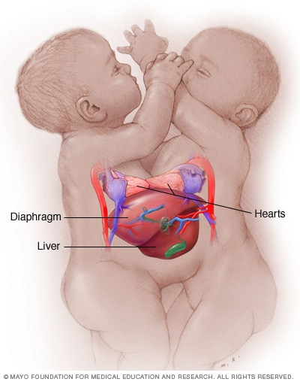

Slide 66
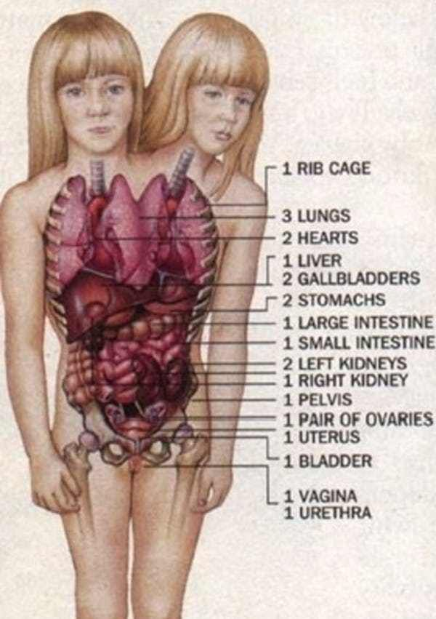

Slide 67
How do we determine life and death?
Circulation- one or two children?
(non-neurological) vital motion?
Neurological function?
Do we want to claim that individual cellular life of neurons are human life?

Slide 69
Thank you
Questions and comments

